Slide 1

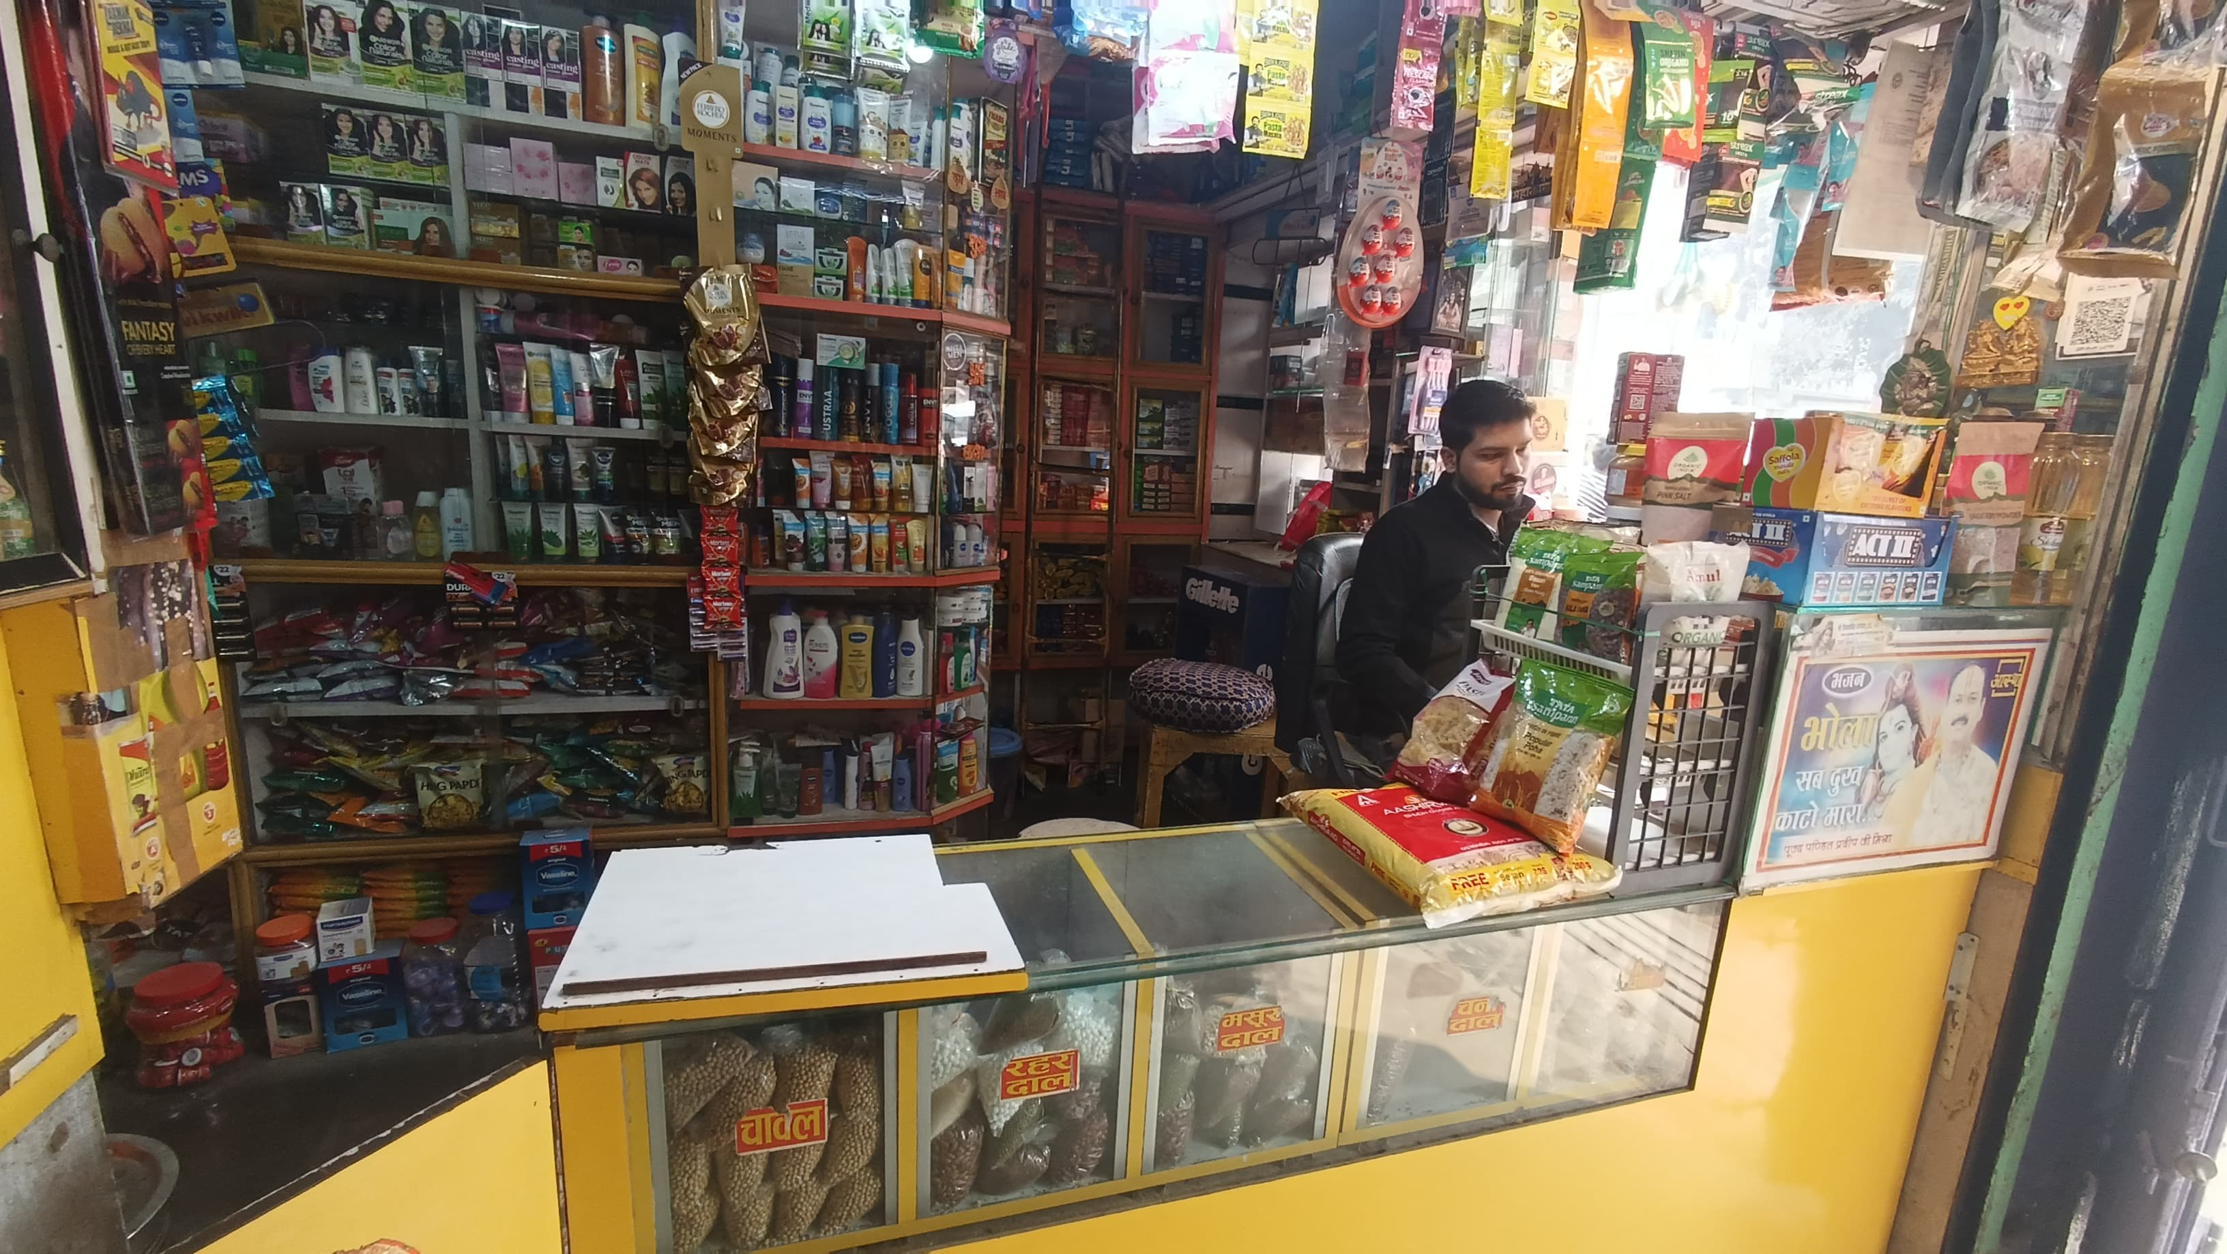
BDM CAPSTONE PROJECT
Name: Omjee Gupta
Roll no: 24F2002843
Email id: 24F2002843@ds.study.iitm.ac.in
TOPIC:
Optimizing Retail Shelf Space, Monthly Demand Prediction, and Stock Availability:
A Data-Driven Approach to Maximizing Profitability and Customer Retention
1

Slide 2
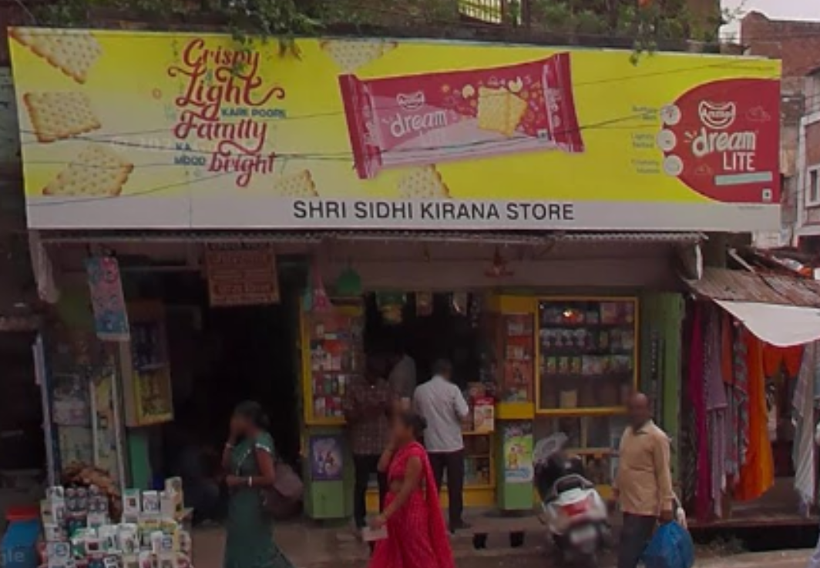
ORGANIZATION BACKGROUND
BDM CAPSTONE PROJECT
Siddhi General Store is a small, local kirana shop located in Ballia, Uttar Pradesh, currently owned by Mr. Kishan Gupta and supported by one worker. The store offers a variety of products, including staples like wheat flour and rice, as well as FMCG items such as chocolates, biscuits, and shampoos. Presently, the shop relies entirely on manual inventory management, which often results in issues like overstocking, stockouts, and inefficient use of space. This project aims to enhance profitability and customer satisfaction through the implementation of data-driven inventory and space management solutions.
Image of Siddhi Kirana Store

Slide 3

PROBLEM OBJECTIVES
IDENTIFIED PROBLEMS
Shelf Space Mismanagement: Low-selling products occupy more shelf space, while high-profit items get less visibility.
Demand Fluctuation Across Months: Purchases are not aligned with actual monthly sales trends and seasonal demand patterns.
Frequent Stockouts of Popular Products: Fast-selling items often go out of stock, causing customers to switch stores, resulting in lost sales and reduced customer loyalty.

Slide 4









SUMMARY OF METHODS AND TOOLS
METHODS USED
DATA COLLECTION
ANALYSIS TOOLS
Bar Graph Analysis: Used to compare unused inventory (Excess Quantity) and sales data to identify overstocked but low-selling items
Time Series (Line Graphs): Helped analyze monthly demand fluctuations for better purchase planning.
Scatter Plot Segmentation: Applied rule-based segmentation to classify products into high, normal, and low demand.
Data Collection: Collected manually from ApnaClub app, handwritten purchase logs, and shop records.
Time Duration: Data covered approximately one year of sales and purchases (JAN24 – DEC24).
Qualitative Insights: Conducted interviews with the shop owner to understand product demand behavior.
Data Cleaning: Missing values were filled using average estimates to ensure consistency.
Python (Google Colab): Used Pandas and NumPy for analysis, and plotting graphs based on rule-based logic.
Excel/Google Sheets: Used for initial data entry, combining monthly reports, and basic statistical calculations.
Rule-Based Thresholds: Applied logic-based conditions to identify patterns through bar, line, and scatter charts

Slide 5
PROBLEM-SOLVING APPROACH
STEP 1
STEP 2
STEP 3
Collected data from ApnaClub app and handwritten bills.
Import PDFs to Excel and merged monthly stock sheets.
Removed unnecessary columns, standardized units, and reconciled item mismatches.
Final structure includes Month ,Items,Purchase Qty,Sell Qty,Purchase Rate,Selling Price,Monthly Sales , Total Cost price , Profit monthly and Profit/item
Collected data from ApnaClub app and handwritten bills.
Import PDFs to Excel and merged monthly stock sheets.
Removed unnecessary columns, standardized units, and reconciled item mismatches.
Final structure includes Month , Items, Purchase Qty,Sell Qty, Purchase Rate , Selling Price , Monthly Sales , Total Cost price , Profit monthly and Profit/item
Analyzed inventory & sales using key metrics: Purchase Qty, Sell Price, Cost Price, Sell Qty, Profit/Item, etc.
Applied descriptive statistics: Count, Mean, Standard Deviation, Min-Max, and Quartiles.
Helped identify overall profit trends and stock performance.
Google Colab was used for problem-wise analysis using Pandas and NumPy.
1. Shelf Space Misuse: Formula: Excess Quantity = Purchase Qty – Sell Qty. Bar Graph with threshold line. Identified products occupying excess shelf space but providing low profit, highlighting inefficiencies.
2. Monthly Stock Imbalance: Formula: Threshold = (Min + Max Purchase Qty) / 2. Monthly Line Graph with reference line to Detected mismatch in purchase and sales trends.
3. Frequent Stock-Outs: Formula: Sell Qty == Purchase Qty and ±20% thresholds. Graph Type: Scatter Plot to identify high demanded products.
Analyzed inventory & sales using key metrics: Purchase Qty, Sell Price, Cost Price, Sell Qty, Profit/Item, etc.
Applied descriptive statistics: Count, Mean, Standard Deviation, Min-Max, and Quartiles.
Helped identify overall profit trends and stock performance.
Google Colab was used for problem-wise analysis using Pandas and NumPy.
1. Shelf Space Misuse: Formula: Excess Quantity = Purchase Qty – Sell Qty. Graph Type: Bar Graph with threshold line. Identified products occupying excess shelf space but providing low profit, highlighting inefficiencies.
2. Monthly Stock Imbalance: Formula: Threshold = (Min + Max Purchase Qty) / 2. Graph Type: Monthly Line Graph with reference line to Detected mismatch in purchase and sales trends.
3. Frequent Stock-Outs: Formula: Sell Qty == Purchase Qty and ±20% thresholds. Graph Type: Scatter Plot to identify high demanded r

Slide 6
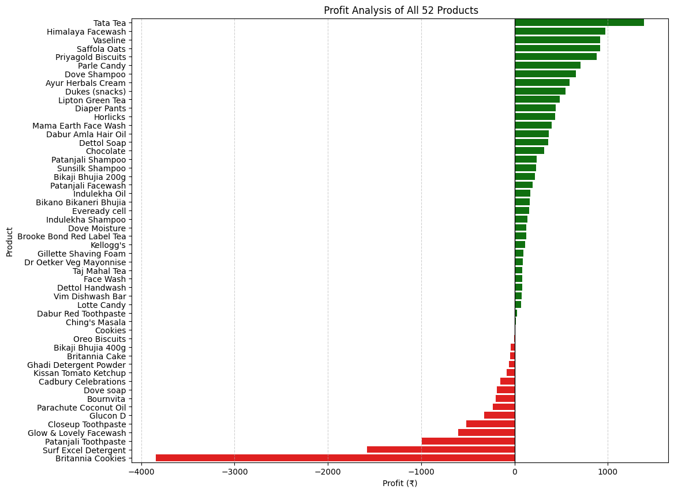
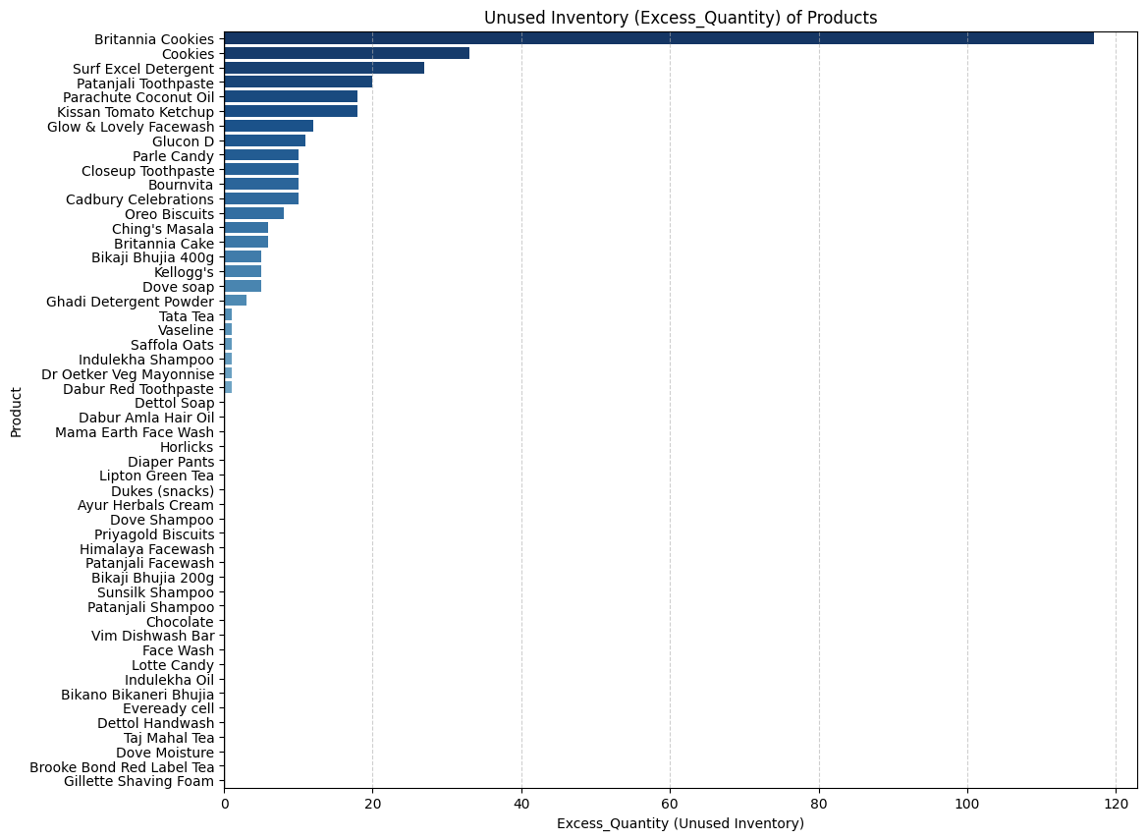
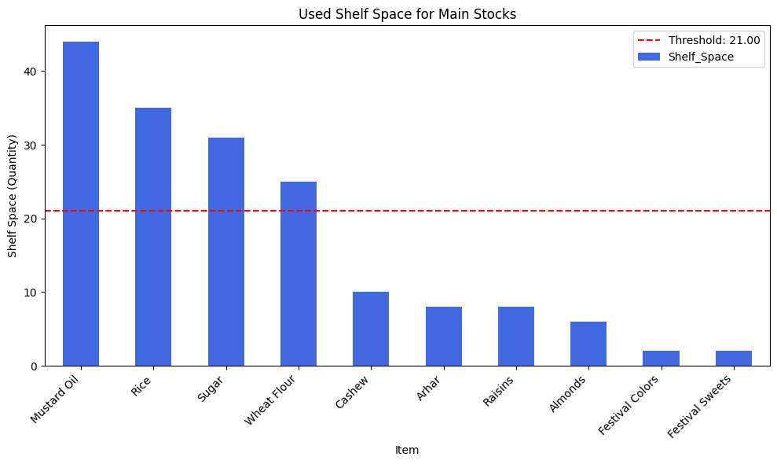
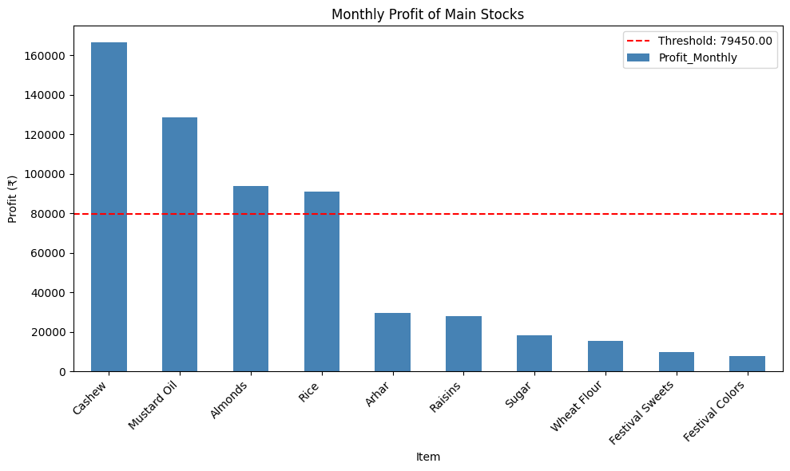
RESULTS & VISUALIZATION 1:
BDM CAPSTONE PROJECT
For Secondary Data
For Main Data
Britannia Cookies occupy 117 Quantity slots but result in a loss of ₹3,842. Similarly, Surf Excel Detergent takes up 27 slots and leads to a loss of ₹1,581.2. Meanwhile, profitable products like Tata Tea (₹1,386 profit,1 slot) and Vaseline (₹920.1 profit,1 slot) don’t have Excess Quantity.
Need to order in average amount: Mustard Oil, Rice, Sugar, Wheat Flour.
Focus on Excess Ordered: Sugar, Wheat Flour.

Slide 7
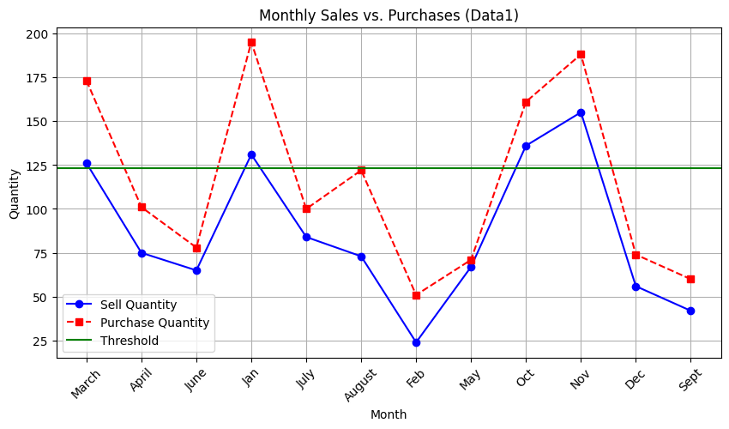
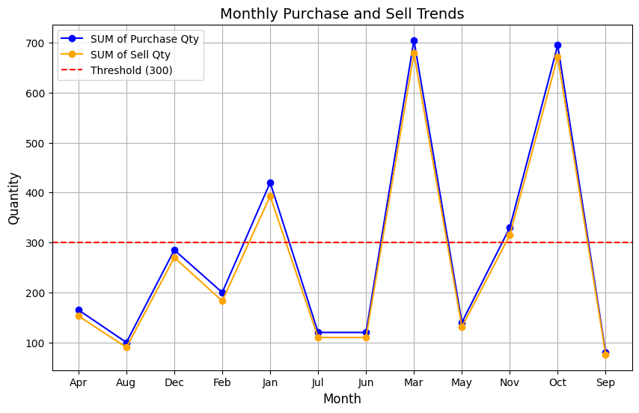
RESULTS & VISUALIZATION 2:
BDM CAPSTONE PROJECT
Overstocking Due to Overestimated Demand
Low Sales in Off-Season Due to Less Consumer Interest
Many months have more stock than required, possibly because of miscalculating demand or a strategy of bulk purchasing to get supplier discounts.
Example: April – Bought 165 units (main) and 101 units (secondary) but sold only 153 units (main) and 75 units (secondary).
February, June, and July have lower sales, which might be due to no major festivals or reduced purchasing power after high spending in previous months.

Slide 8
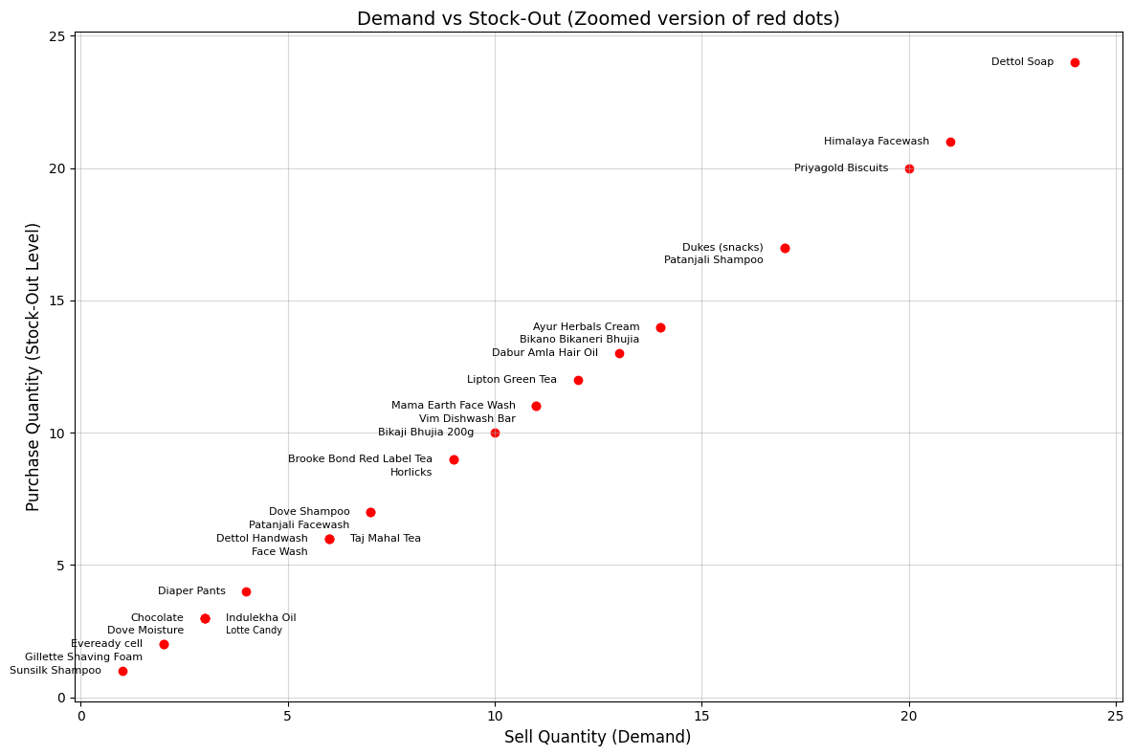
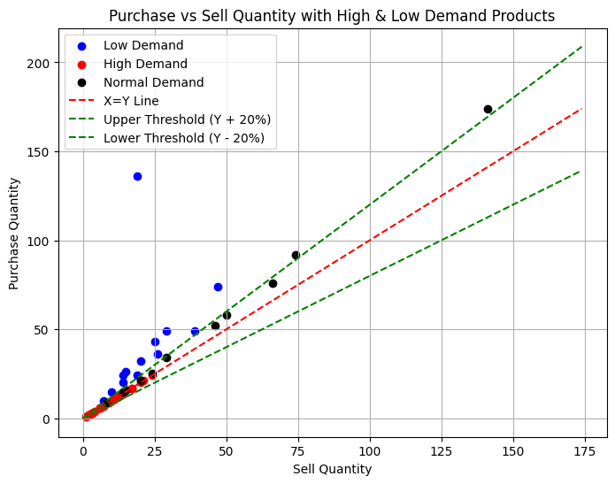
RESULTS & VISUALIZATION 3:
BDM CAPSTONE PROJECT
Frequent Stock-Outs for Popular Products
Slow-Moving & Moderate-Demand Items
Certain products have consistently high sales but often run out of stock, suggesting that their demand is underestimated. This can lead to lost sales opportunities.
Example: Products such as Dettol Soap (24 units purchased and sold) and Dukes Snacks (17 units purchased and sold) were completely sold out.
Overstocked items like Britannia Cookies (136 bought, 19 sold) and Kissan Ketchup (43 bought, 25 sold) increase storage costs. In contrast, balanced items such as Ching’s Masala (52 bought, 46 sold) and Saffola Oats (25 bought, 24 sold) reflect efficient stock management.

Slide 9


RECOMMENDATION
SHORT – TERM RECOMMENDATION
Utilize Bundling Strategies: Combine slow-selling items with fast-selling ones (e.g., offer 12-pack biscuits at a discount).
Target Nearby Markets: Sell excess stock in bulk to local restaurants, sweet shops, and caterers.
Strategic Product Placement: Position fast-moving and impulse-buying items at eye-level or near the counter for quick visibility.
LONG – TERM RECOMMENDATION
Data-Driven Stocking & Purchase Decisions: Base stock purchases on historical sales data—no guesswork involved.
Seasonal Demand Forecasting: Plan inventory in advance according to festivals and seasonal trends.
Dynamic Supplier Contracts: Choose suppliers who offer flexibility and quick delivery in response to demand spikes.

Slide 10
THANK YOU
Open to Questions!!

